Slide 1
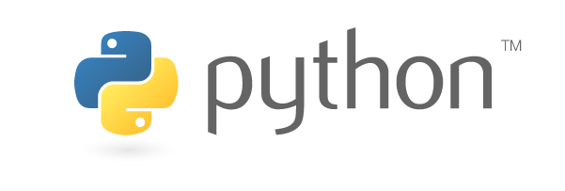
FAIM Python Course – Session 3
Image Processing
benjamin.titze@fmi.ch
Facility for Advanced Imaging and Microscopy (FAIM)
5 November 2020

Slide 2
Outline
Prerequisites: Python 3.6 and Jupyter Notebook
Libraries: pillow (PIL), scikit-image, NumPy, SciPy, Matplotlib
Overview: Digital image processing
Introduction to the libraries
Examples of common tasks (in Jupyter Notebook)
Loading, manipulating and saving images
Extracting image statistics
Applying filters/thresholds
Object detection

Slide 3
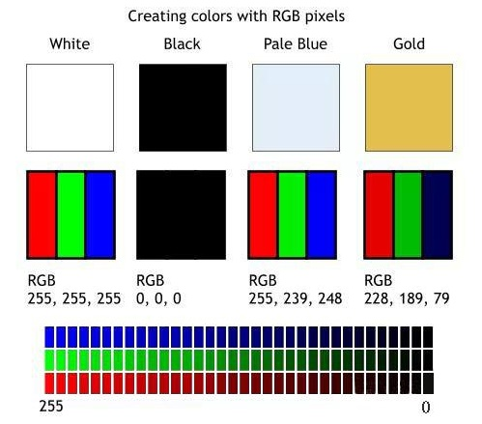
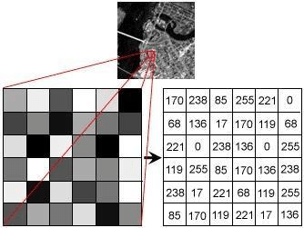
Illustration: Goutam Das
Illustration: www.panadisplay.com
A digital image is a 2D array of pixels.
Every pixel has a coordinate (x/y = column position/row position starting from 0/0 in upper left corner)
and an intensity value (typically 8 bit or 16 bit for greyscale, or 3 × 8 bit = 24 bit for RGB).

Slide 4
(Bio)Image Processing/Analysis
Common tasks:
I/O: Loading images into memory for processing, saving (processed) image data from memory to disk, converting between formats and bit-depths (tiff, png, jpg…; 8 bit, 16 bit…)
Image manipulation: Brightness & contrast; Cropping, resizing, rotation, flipping, …
Image statistics: Mean, standard deviation, histogram…
Applying filters: Denoising, edge detection…
Extraction of relevant information: Spot detection, segmentation…
Please note that this session is not aimed at teaching fundamental image processing concepts (see Jan’s introductory courses for that), but at giving you an overview how Python can be used for image processing.

Slide 5



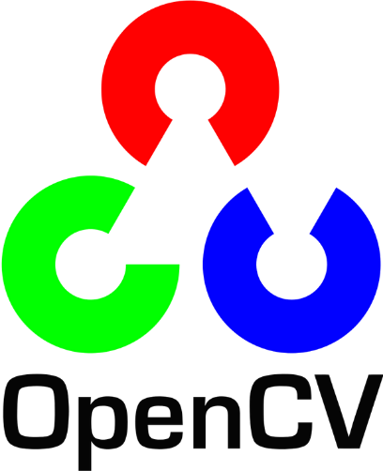
Recommended as default choice for most applications
(pronounced Num Pie) – https://numpy.org
A library for fast manipulation of multidimensional numerical data. The basic type ndarray is a multidimensional array with zero-based indexing.
(pronounced Sigh Pie) – https://www.scipy.org
A scientific computing library (built with NumPy arrays) with various modules for numerical integration, linear algebra, image processing, Fourier transforms, signal processing, statistical functions…
https://scikit-image.org
Image processing toolkit with lots of useful functionality in one place. Started out as a SciPy toolkit (= ‘scikit’) in 2009. Works very well with NumPy and SciPy. As of 2020 probably the best choice for your image processing needs. Imported as skimage.
https://python-pillow.org
pillow is a fork of the Python Imaging Library (PIL), a project to provide basic imaging processing capabilities in Python. PIL was discontinued in 2011. The package is called ‘pillow’, but in Python it’s used with ‘import PIL’.
https://opencv.org
OpenCV (CV for Computer Vision) is a cross-platform library written in C/C++, started by Intel, now developed by the non-profit OpenCV foundation. Can be used in Python with the wrapper package opencv-python.
… and there are more packages to explore: https://opensource.com/article/19/3/python-image-manipulation-tools

Slide 6
Hands-on examples in Jupyter Notebook:
Load, transform and save images with Pillow (PIL)
→ loading-and-manipulating-images.ipynb
Images as NumPy arrays, image statistics, histograms
→ image-statistics.ipynb
Applying filters and thresholds
→ filtering-and-thresholds.ipynb
Blob detection (detect objects in Hubble image)
→ blob-detection.ipynb
Segmentation example (nuclear division time series)
→ segmentation-example.ipynb

